Slide 1
Developer Experience
What is DX, how to measure it, challenges and other topics
ASW 2022/2023
Álvaro González Erigoyen, UO282790 Andrés Cadenas Blanco UO282276 Iván Vega García UO276670

Slide 2

Abi noda
Cutie!!
Founder of Pull Panda and GetDX researcher
"I believe that productivity is ultimately around how developers feel, because software development is not an assembly line. It’s not a factory where you can just count the widgets coming out."

Slide 3


What is dx?
Classic definition
Modern definition
Solutions
Tools
Experiences
Feelings
???

Slide 4


Why is it important?
↑ DX = ↑ Productivity
Why should companies care?
↑ DX = ↑ Retaining

Slide 5

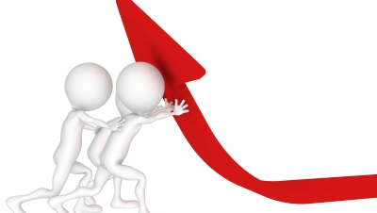
Benefits of DX
Predicting productivity and satisfaction
Improving individual performance
More attractive when finding jobs
Notes:
American view of work where productivity is more important tan satisfaction, they implye the second comes from the first.

Slide 6

Which problems do we face as Programmers?
(Other than bugs)
Notes:
Yes,

Slide 7
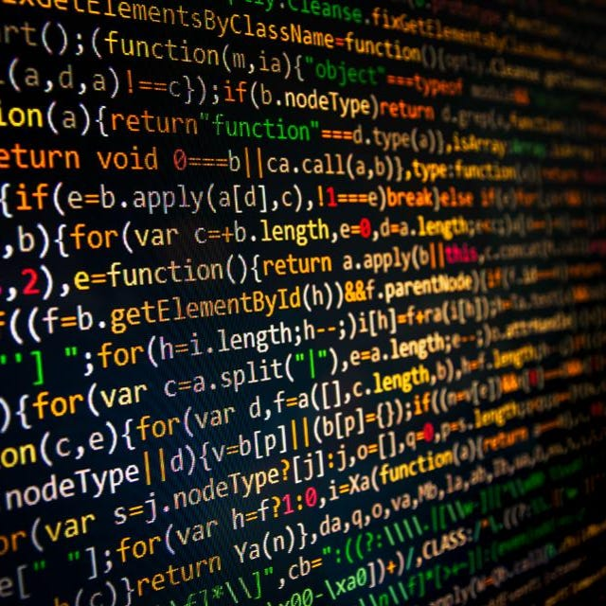

Do Programmers Face Problems?
(Yes we are using stock photos so what :p)
Local Problems
Local Problems
VS
Global Problems
VS
Global Problems
Notes:
Complexity,Meetings,etc.. General ones are the ones that affect other teams such as bad tolos.

Slide 8

Improving dx
Why should companies care?

Slide 9

Job crafting
Tweaking position → Better fit
Don’t like your job? Change it!

Slide 10


DX teams
Review, measure and improve
DX as a service?
Developer = Customer

Slide 11

metrics
How to measure something abstract

Slide 12


System metrics
Self-reports

Slide 13
Alternative metrics
System metrics
Self-reported measures
Empirical data
Easier to measure
Has no no business context
Personal data
More difficult to quantify and measure
Takes into consideration the end-to-end nature of develpment

Slide 14


Slide 15
Productivity, what is it?

Slide 16
We don't know

Slide 17
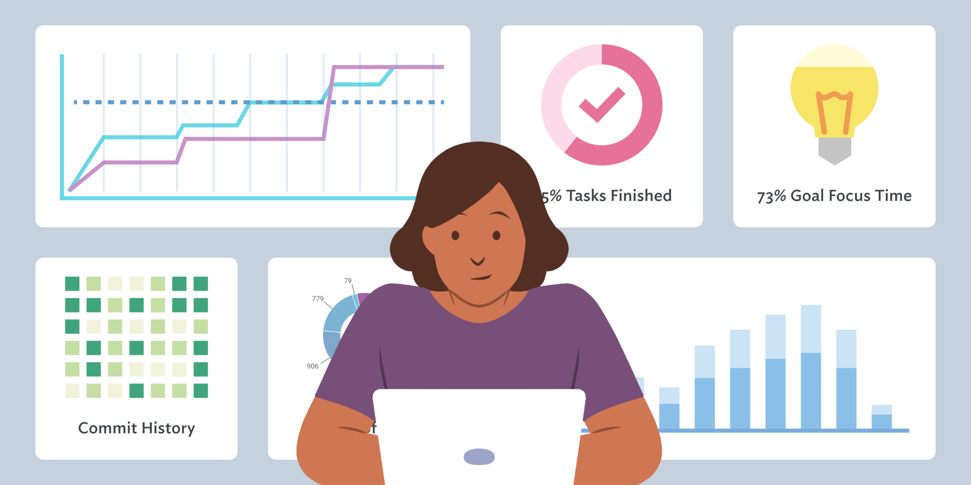

Slide 18

barriers
And how to surpass them

Slide 19

Don't know
Don't
Prioritize
Don't
SOLve

Slide 20


Slide 21



Slide 22
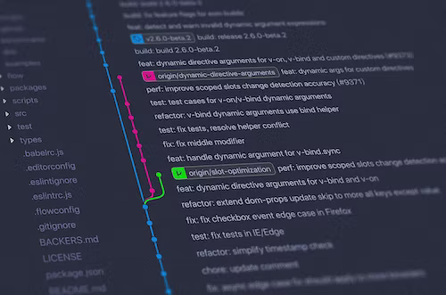
Code review challenges
Key part in development!
Ensure quality
Exhausting… but necessary

Slide 23
Who suffers what
Programmer
reviewer
Time taken
Harshness
Amount of feedback
Bad documentation
Unclear changes
Missed points
communication, please

Slide 24
Good documentation!
Simple, but often overlooked

Slide 25

A tool for job hunting
And a few tips for our future

Slide 26
How Companies advertise DX
There is no formal way to measure the DX sadly
Big companies tend to fight for their DX reputation
There is an increasing trend

Slide 27

What should we search?
Interviews are a two-way share of information
Companies should provide Open-source projects of employees
Self reports of employees and reputation

Slide 28
What should we ask?
What is the process you must go to actually set up the code locally, to create it or to run it? Is that difficult?
Which reviewing process is followed?
How is the aproval process done?
Is the time of the feedback loop frustrating?
Is it fun or enjoyable to work at that company?

Slide 29

Thank you for listening
Question time!

